Slide 1
Digital Electronics and Computer Organization Lab Course Code: CSE207

Slide 2
Experiment 7
To simulate 4 bit BCD adder
www.circuitverse.org (as a simulator)

Slide 3
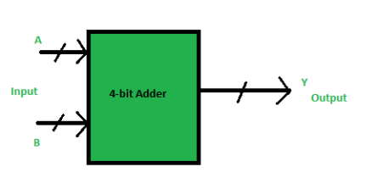
BCD ADDER
BCD stand for binary coded decimal.
Suppose, we have two 4-bit numbers A and B.
The value of A and B can vary from 0(0000 in binary) to 9(1001 in binary)

Slide 4
The output will vary from 0 to 18, the carry from the previous sum is not considered.
But if the carry is considered, then the maximum value of output will be 19 (i.e. 9+9+1 = 19).
When A and B are added, then the binary sum is obtained. Here, to get the output in BCD form, BCD Adder is used

Slide 5
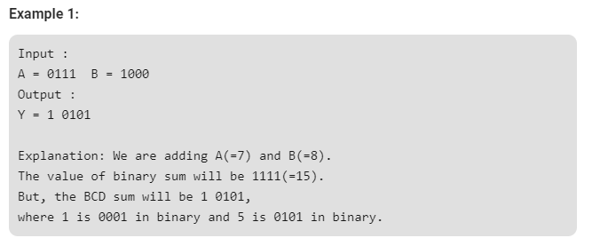

Slide 6
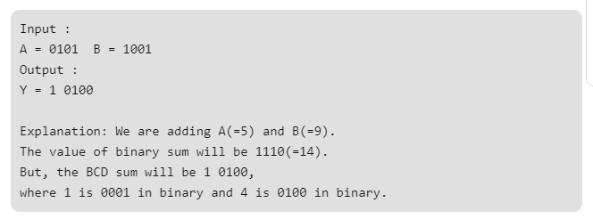
if the sum of two number is less than or equal to 9, then the value of BCD sum and binary sum will be same otherwise they will differ by 6(0110 in binary).

Slide 7
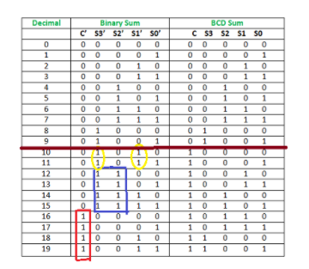

Truth table
The conditions are:
If C’ = 1 (Satisfies 16-19)
If S3′.S2′ = 1 (Satisfies 12-15)
If S3′.S1′ = 1 (Satisfies 10 and 11)

Slide 8
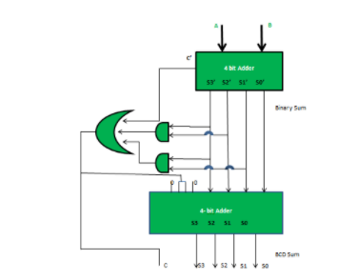
Circuit diagram of 4- bit BCD ADDER

Slide 9
Circuitverse.org
Launch Simulator
Draw the logic circuit diagram of BCD ADDER
Make sub-circuit of FA
Make a sub-circuit of 4 bit adder
Use it to make a BCD ADDER
Simulate the circuit and verify the truth table

Slide 10
Lab File
Experiment No.: 7
Aim: Simulation of 4 bit BCD adder
Platform/Tool used: Circuitverse.org simulator
Theory: Include definition, working and truth table of BCD adder
Simulated Output: Simulated output snapshots on circuitverse
Result: The BCD adder circuit was designed and simulated using online simulator and waveforms were verified

Slide 11
Practice
Design and simulate a full adder circuit using NAND gates only

Slide 12
Thank you

